Slide 1


Daily Gold Price Prediction
Work done by:
Ana Rita Cheganças nº 104633
Nuno Pedrosa nº 94471
Time Series 21/22
Profª. Doutora Isabel Pereira

Slide 2

Introduction
Is a scarce material, thus, its value is completely based around its durability and quality, which has been maintained over time.
Nowadays gold came to be regarded primarily as a store of value.
It is very important to have a forecast of the price of gold.

Slide 3
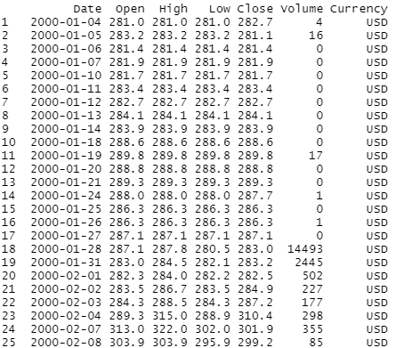
DataSet
Taken from Kaggle website, presente in the folowing link:
https://www.kaggle.com/datasets/psycon/daily-gold-price-historical-data
5753 rows;
Starting in 2000-01-04;
Ending in 2022-06-22;
Aproximately 255 per year;

Slide 4
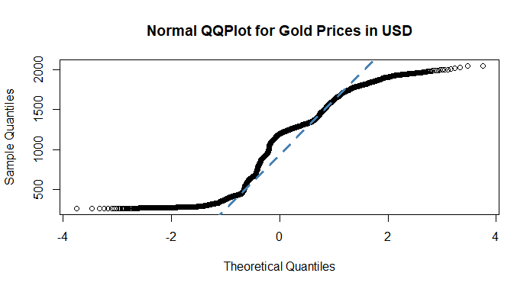
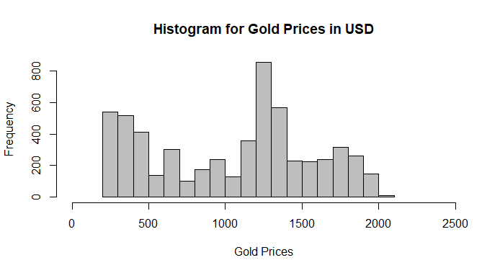
Exploratory Analysis
Average closing price and variance of 1044.9 and 269110.4, respectively.
The lowest price was around 255.1, and the highest price was 2054.6.

Slide 5
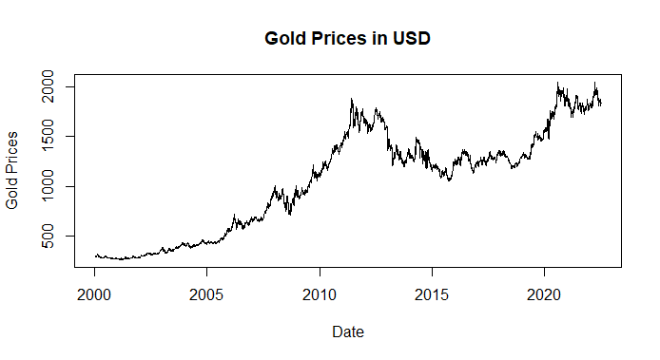
Exploratory Analysis

Slide 6
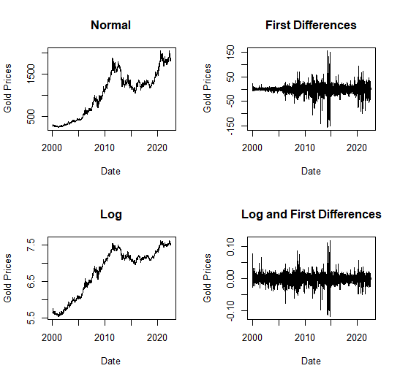
Data Manipulation
Taking into account the results achieved, we started to use:
Data with the values ​​calculated through the logarithm
Data of the 1st differences of the logarithm.

Slide 7
Stationarity Analysis
Adf test
Logarithm -> H0 is not rejected, it do not shows stationary -> Random Walk.
1st differences of the logarithm -> H0 is rejected, it has stationarity -> White Noise.
Kpss test
Both datas -> H0 is rejected, it has stationarity.
Confirms that the data for logarithms and first differences are indeed stationary
Shows that the logarithm-only data is trend stationary.

Slide 8
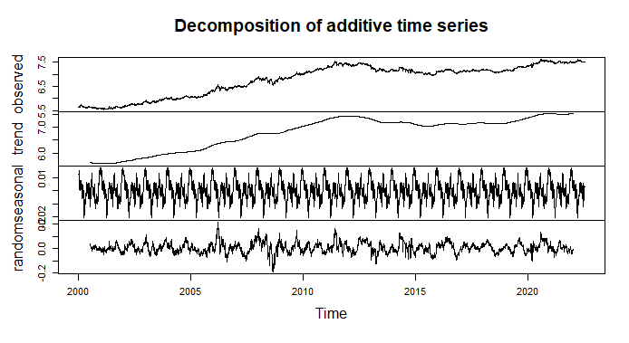
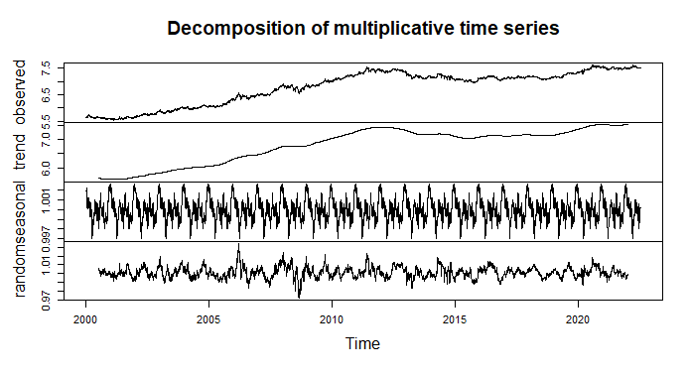
Decomposition Analysis
Decomposition of the Log Data

Slide 9
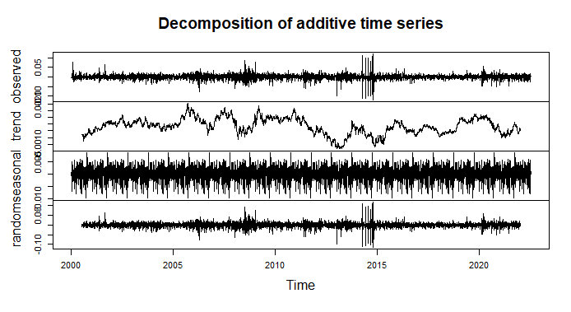
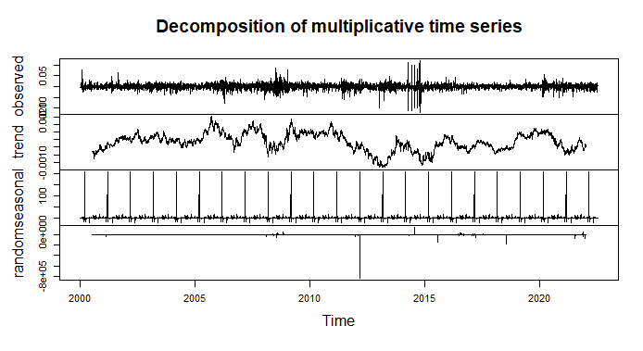
Decomposition Analysis
Decomposition of the Log and First Differences Data

Slide 10
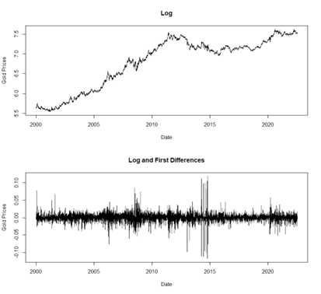
Train Test Split
Test data are the last 200 values ​​of the previously obtained time series.
Values from 2021-09-21 until 2022-06-22.
Plot of the train Data.

Slide 11
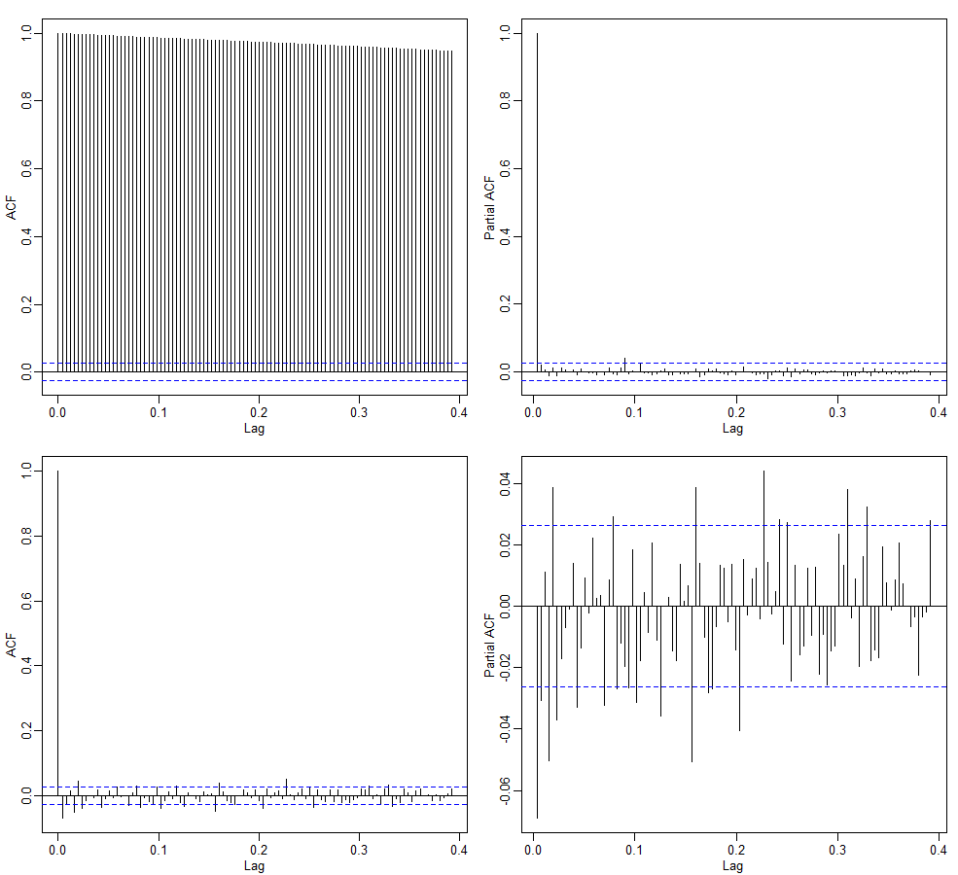
ACF and PACF Analysis
Log Data
1º line
Log and First Diferences Data
2º line
Supports the result of the stationarity tests.
Our models will be ARIMA type, we can’t draw concrete conclusions about the parameters just looking at the ACF and PACF.

Slide 12
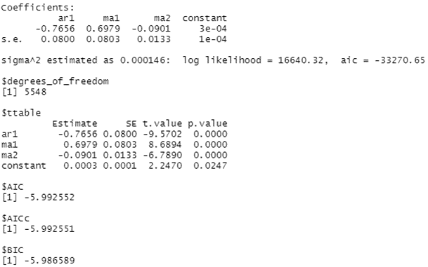
SARIMA Models
ARIMA(1,1,2) model for logarithmized data.

Slide 13
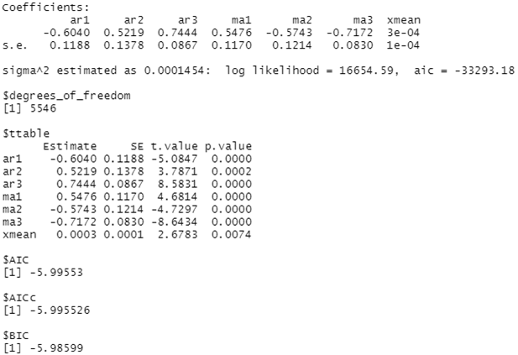
SARIMA Models
ARIMA(3,0,3) model for logarithmized with first differences data.

Slide 14
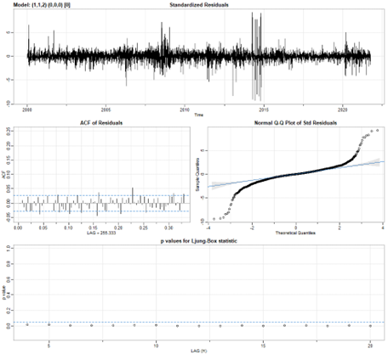
SARIMA residual analysis
ARIMA(1,1,2) model for logarithmized data.
Box.test at lag 10 to test the correlation between residuals:
The residuals aren’t a white noise at lag 10.
Shapiro and Kolmogorov-Smirnov tests to test for normality:
Residuals do not follow a normal distribution.

Slide 15
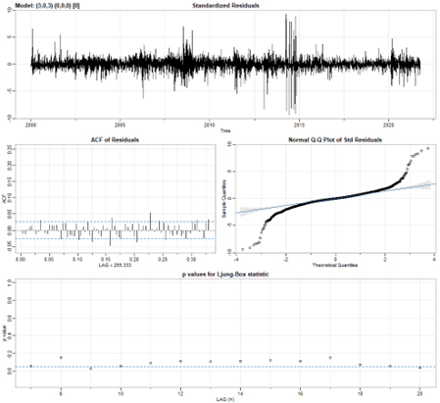
SARIMA residual analysis
ARIMA(3,0,3) model for logarithmized with first differences data.
Box.test at lag 10 to test the correlation between residuals:
The residuals are a white noise at lag 10.
Shapiro and Kolmogorov-Smirnov tests to test for normality:
Residuals do not follow a normal distribution.

Slide 16
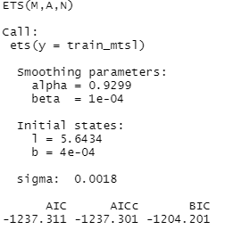
ExponenTial Smoothing (ETS) Models
ETS(M,A,N) model for logarithmized data.

Slide 17
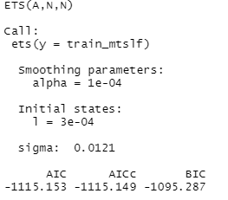
ExponenTial Smoothing (ETS) Models
ETS(A,N,N) model for logarithmized with first differences data.

Slide 18
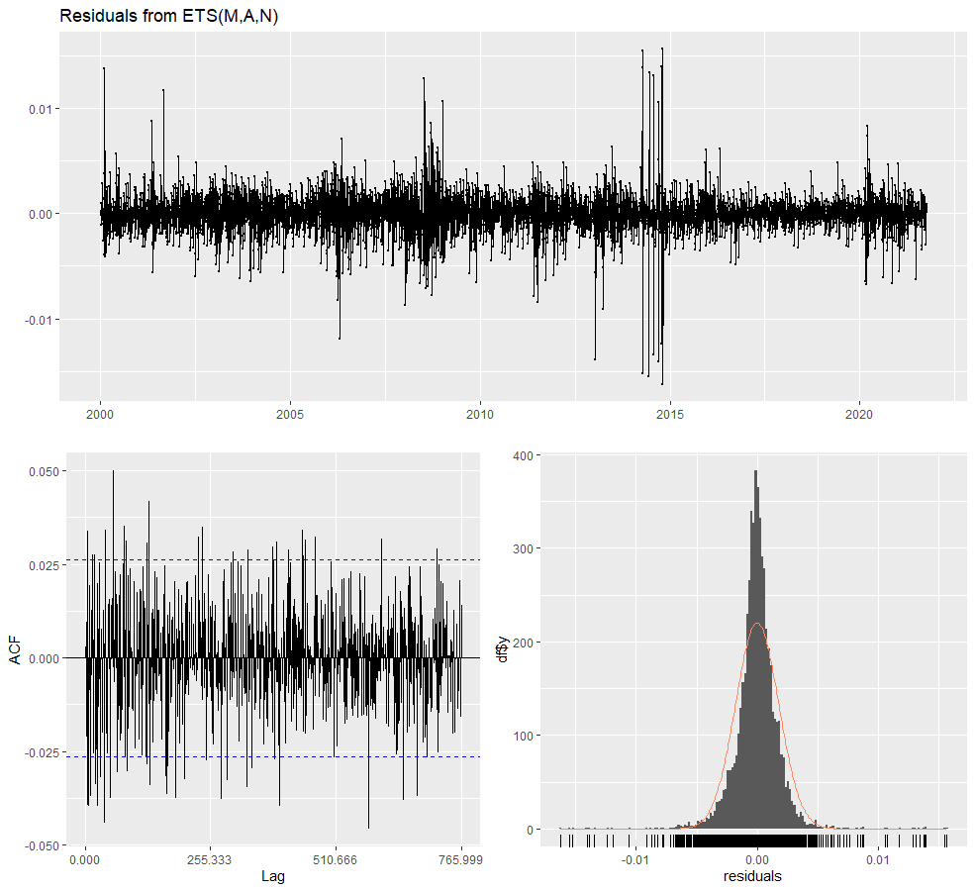
SARIMA residual analysis
ETS(M,A,N) model for logarithmized data.
Box.test at lag 10 to test the correlation between residuals:
The residuals aren’t a white noise at lag 10.
Ljung-Box to test the correlation between residuals:
For a total of 510,666 used lags, there is correlation between residuals.
Shapiro and Kolmogorov-Smirnov tests to test for normality:
Residuals do not follow a normal distribution.

Slide 19
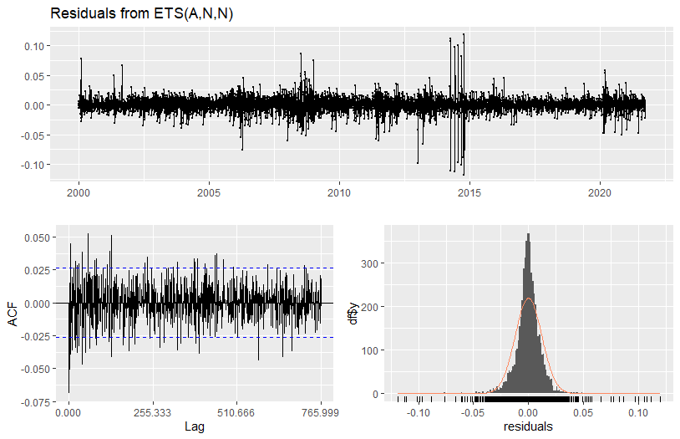
SARIMA residual analysis
ETS(A,N,N) model for logarithmized with first differences data.
Box.test at lag 10 to test the correlation between residuals:
The residuals aren’t a white noise at lag 10.
Ljung-Box to test the correlation between residuals:
For a total of 510,666 used lags, there is correlation between residuals.
Shapiro and Kolmogorov-Smirnov tests to test for normality:
Residuals do not follow a normal distribution.

Slide 20
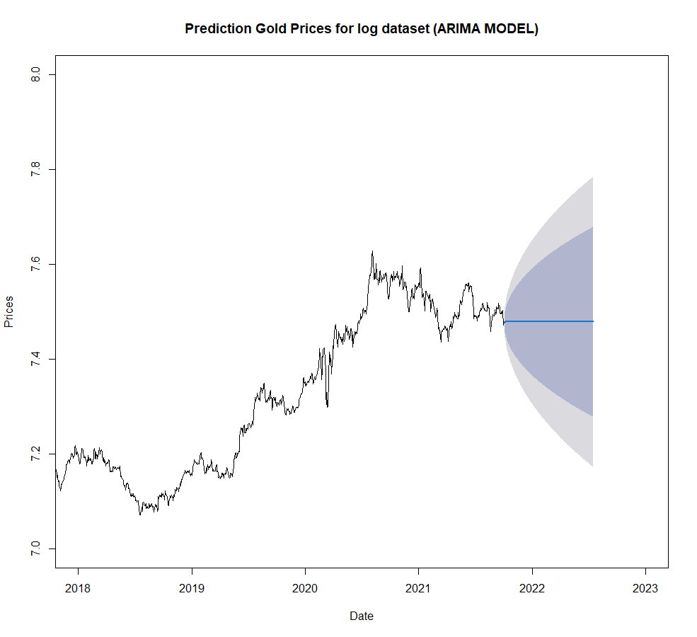
Forescasts
ARIMA(1,1,2) model for logarithmized data.
Train RMSE (Root Mean Square Error) of 0.0121
Train MASE (Mean Absolute Standardized Error) of 0.05473
Test RMSE of 0.0571
Test MASE of 0.31897

Slide 21
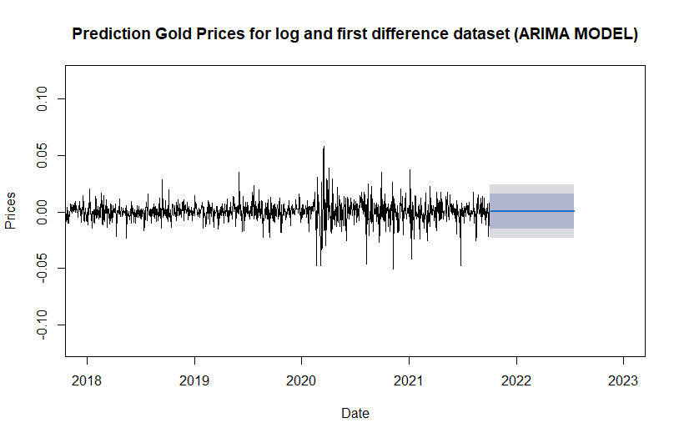
Forescasts
ARIMA(3,0,3) model for logarithmized with first differences data.
Train RMSE (Root Mean Square Error) of 0.0120
Train MASE (Mean Absolute Standardized Error) of 0.6614
Test RMSE of 0.0092
Test MASE of 0.5807

Slide 22
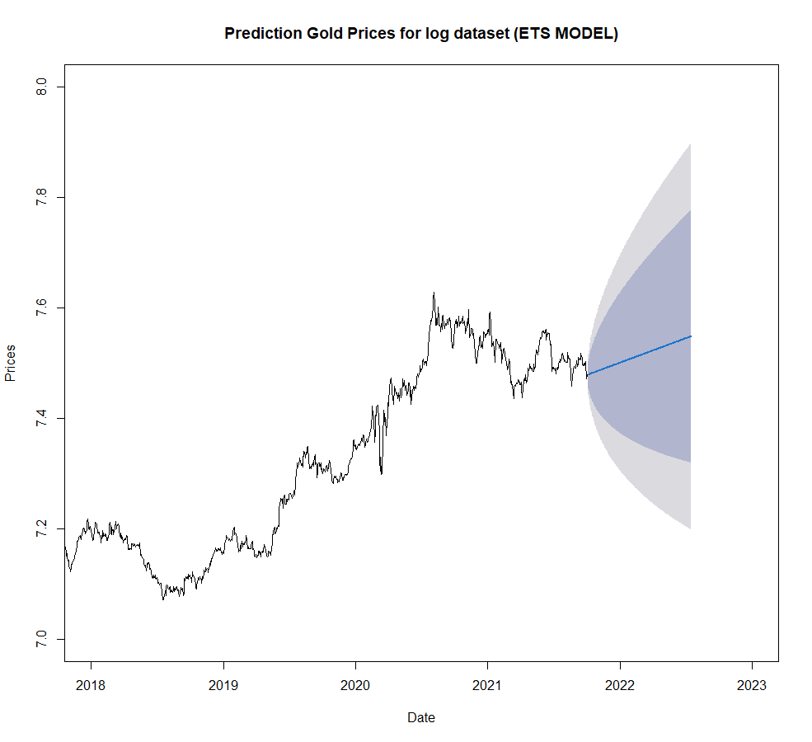
Forescasts
ETS(M,A,N) model for logarithmized data.
Train RMSE (Root Mean Square Error) of 0.0120
Train MASE (Mean Absolute Standardized Error) of 0.0546
Test RMSE of 0.0298
Test MASE of 0.1538

Slide 23
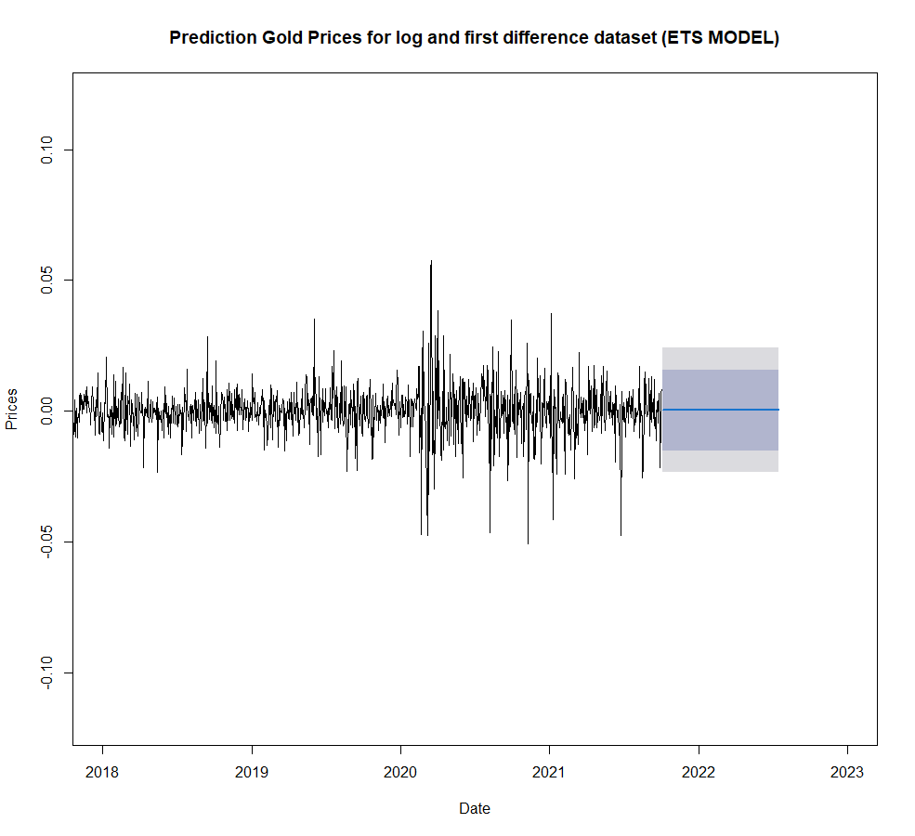
Forescasts
ETS(A,N,N) model for logarithmized with first differences data.
Train RMSE (Root Mean Square Error) of 0.0121
Train MASE (Mean Absolute Standardized Error) of 0.6610
Test RMSE of 0.00919
Test MASE of 0.5806

Slide 24
Conclusions
The most accurate is the ETS model with logarithmized data. With RMSE of 0.0120, and a MASE of 0.0546 for training data. In the test data, an RMSE of 0.0298 and a MASE of 0.1538 were obtained.

Slide 25
Bibliography
Athanasopoulos, G., & Hyndman, R. (2018). Forecasting: Principles and Practice 2nd Edition. Monash University, Australia: Texts.
Hyndman, R., Koehler, A., Ord, J., & Snyder, R. (2011). Forecasting with Exponential Smoothing: The State Space Approach.
Pereira, I. (2021/2022). Time Series: Section 3. Modeling SARIMA processes.
Pereira, I. (2021/2022). Time Series: Section 4. Forecast.
Pereira, I. (2021/2022). Time Series: Section 6. Exponential Smoothing Methods.
Shewhart, A., & S.Wilks, S. (2010). Time Series Application to Finance.

